Slide 1
Microsoft Windows 7 Basics
Microsoft Office 2010 Introductory
Pasewark & Pasewark

Slide 2
Objectives
Start Windows.
Use a pointing device.
Understand the desktop.
Navigate in Windows.
Use Windows.
2
2

Slide 3
Objectives (continued)
Manage files and folders.
Delete files using the Recycle Bin.
Use Windows Help.
Manage your computer.
3
3

Slide 4
Vocabulary
Action Center
Address bar
Close button
Computer folder
Control Panel
desktop
Explorer window
Favorites
jump list
Libraries
Notification area
operating system
pin
pointer
4
4

Slide 5
Vocabulary (continued)
pointing device
Recycle Bin
Start button
taskbar
window
Windows Aero
5
5

Slide 6
Starting Windows
Windows 7 is an operating system that controls basic computer operations.
If Windows is already installed, it should start automatically when you turn on the computer.
Most Windows 7 editions support Windows Aero, a graphic interface feature that gives a translucent quality to windows.
6
6

Slide 7
Using a Pointing Device
A pointing device allows you to interact and communicate with your computer.
A pointing device can be a mouse, trackball, touch pad or screen, pointing stick, digital pen, or even a joystick.
The pointer, which appears as an arrow on the screen, indicates the position of the pointing device.
7
7

Slide 8
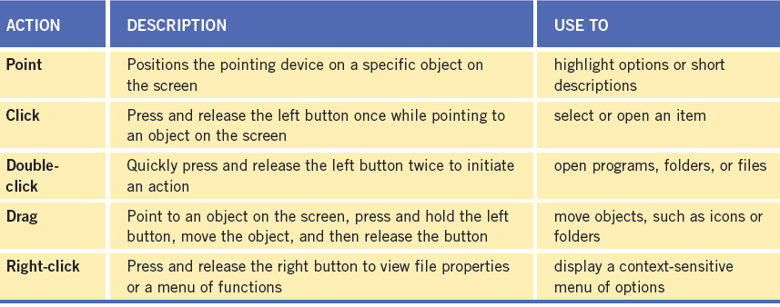
Using a Pointing Device (continued)
Common pointing device actions

Slide 9
Understanding the Desktop
Files and folders, directories that contain files or other folders, are displayed in a small framed work area known as a window.
The desktop is the main work area in Windows. It contains Windows program elements, other programs, and files.
The taskbar appears at the bottom of the screen and displays program icons.
9
9

Slide 10
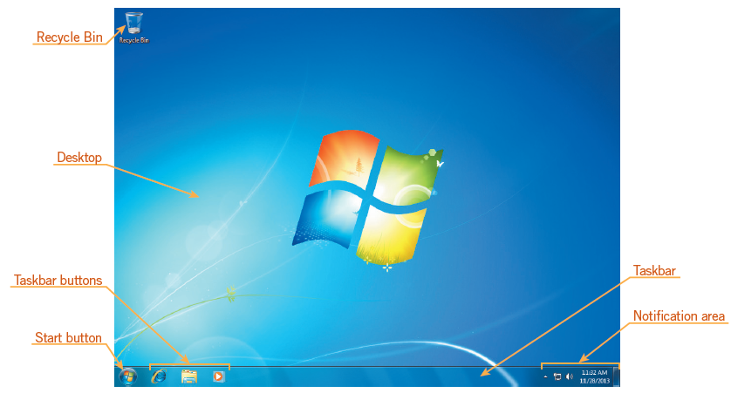
Understanding the Desktop (continued)
Typical Windows 7 desktop

Slide 11
Navigating in Windows
Explorer windows are used to navigate to items on your computer.
Most windows share common navigation tools such as a Navigation pane, Address bar, toolbar, or Close button.
Each window has a toolbar, controls, or links that contains functions specific to the window.
11
11

Slide 12
Navigating in Windows (continued)
The Address bar identifies the path for the currently open folder.
Use the Navigation pane to navigate to popular or common locations and recently used files and folders.
Favorites link to folders containing the items you use the most
Libraries provide a view of related files and folders in a single location.
12
12

Slide 13
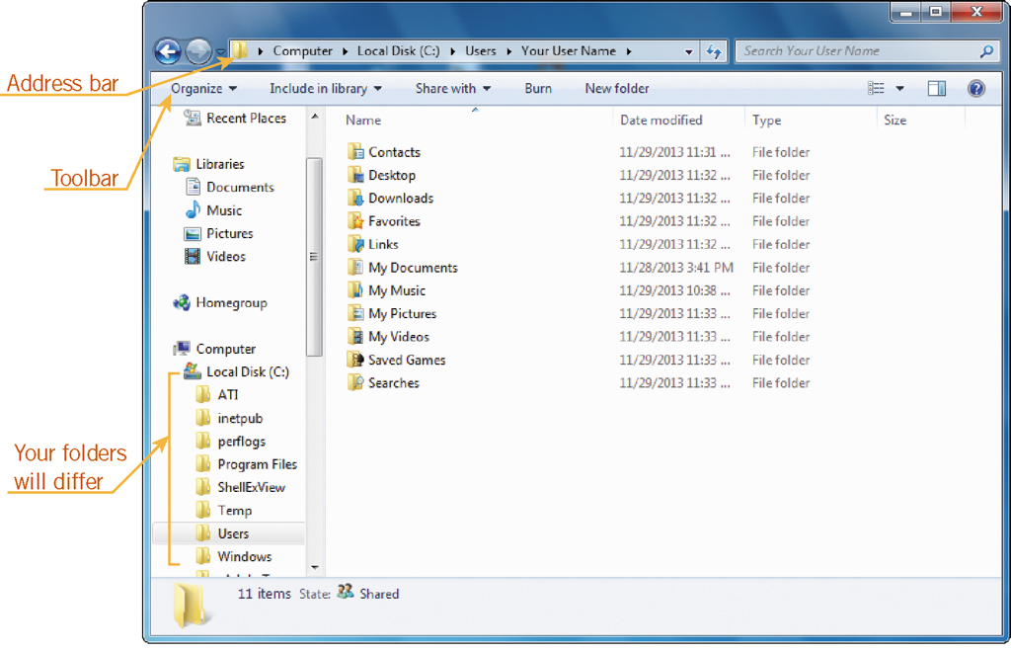
Navigating in Windows (continued)
Viewing a path in the Address bar

Slide 14
Using Windows
Windows are essential to using the Windows 7 operating system.
To move a window, click the title bar, and drag the window to another location.
You can change the size of a window by
Using the sizing handles
Using the Maximize, Minimize, or Restore Down buttons
14
14

Slide 15
Using Windows (continued)
A scroll bar appears on the edge of a window any time there is more content than can fit.
Commands and buttons are usually contained on a menu, a toolbar, or in a dialog box.
Toolbar: Contains buttons that execute a function or open a command menu.
Menu: Contains commands for initiating actions/tasks.
Dialog box: Interactive message window appears when more information is required.
15
15

Slide 16
Using Windows (continued)
The Control Panel, shown in Figure 1–15, is the command center for configuring Windows settings.
To find the settings you are interested in, type a word or search term in the Search text box.
16
16

Slide 17
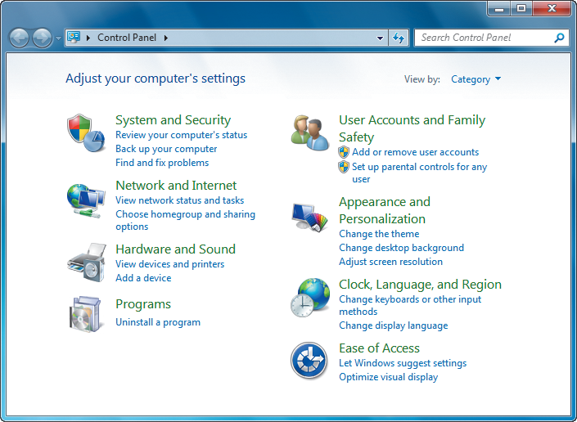
Using Windows (continued)
Control Panel

Slide 18
Managing Files and Folders
Each registered user has the same default Library folders, such as Documents, Pictures, and Music, which you can easily access on the right pane of the Start menu.
The Computer folder is where you access hard disk drives, removable drives and media, CD and DVD drives, network locations, and other removable media.
18
18

Slide 19
Deleting Files Using the Recycle Bin
When you delete a file from a window, the file is physically moved to the Recycle Bin.
Fortunately, just like a regular wastebasket, you can retrieve items before they’re gone for good.
Once you choose to permanently delete an item, by emptying the Recycle Bin, you cannot restore it.
19
19

Slide 20
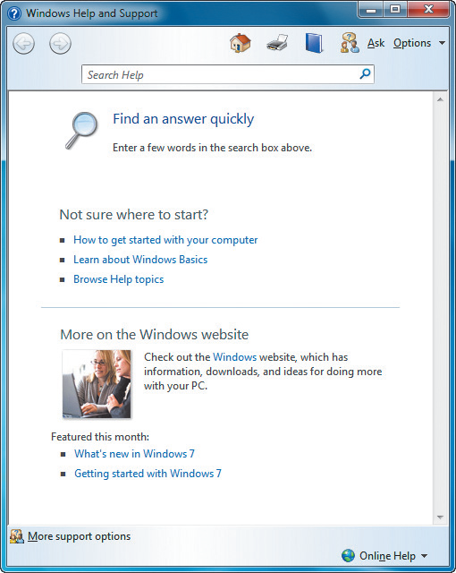
Using Windows Help
You can access Windows Help by clicking Help and Support on the Start menu.
Windows Help and
Support window
20
20

Slide 21
Managing Your Computer
Windows provides Disk Cleanup, a utility that deletes temporary files created when you surf the Web, watch videos, edit files, or perform other actions.
The Action Center provides important messages about critical security and maintenance components on your computer, such as the firewall, antivirus protection, and spyware protection.
21
21

Slide 22
Summary
In this lesson, you learned:
Starting Windows brings up the desktop, and possibly a prompt to enter a password depending on your settings. Several different versions of Windows 7 are available.
A pointing device, such as a mouse, trackball, touch pad, or pointing stick, is a device you use to interact with and navigate your computer. You can use a touch screen to interact with the computer.
22
22

Slide 23
Summary (continued)
The desktop is the main work area, and contains access to Windows elements such as files, folders, and programs, all of which are represented by icons. The main features of the desktop are the Start button, Recycle Bin, desktop theme, taskbar, notification area, and gadgets.
23
23

Slide 24
Summary (continued)
Windows contains toolbars, controls, or links for a specific function. You can switch between open windows, open different folders by clicking folders in a path on the Address bar, and using the Navigation pane to open and organize folders.
24
24

Slide 25
Summary (continued)
Windows can be moved, resized, opened, and closed. If you are unable to display all the contents of a window as it is currently sized, scroll bars appear to allow you to move to the part of the window that you want to view. Windows can be maximized to fill the screen or minimized to appear as a button on the taskbar. You can use toolbars and menus in windows to perform tasks or actions, and input information in dialog boxes. The Control Panel contains searchable links for configuring Windows settings.

Slide 26
Summary (continued)
Windows provides several default library folders for storing and organizing files on your computer and for viewing similar files, sharing files, or accessing frequently used files.
The Recycle Bin stores files you have deleted from your computer. You can restore deleted files that are placed in the Recycle Bin or delete them permanently from your computer.

Slide 27
Summary (continued)
The Windows Help and Support window provides additional information about the many features of Windows. You can access the Help program from Start menu or from any Windows program.
Windows provides several utilities you can use to clean up unnecessary files on your computer and check your computer’s security settings.

